Slide 1
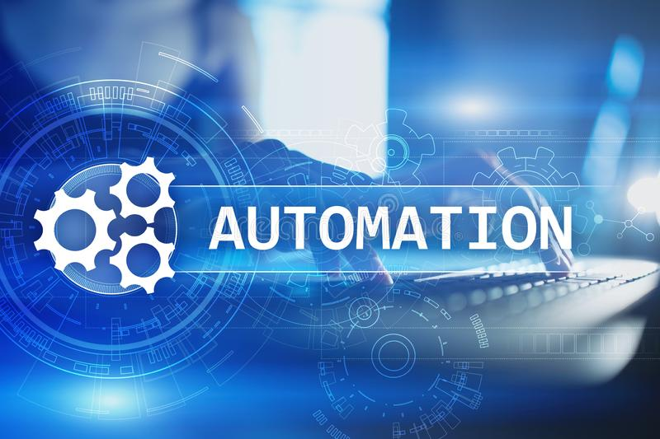
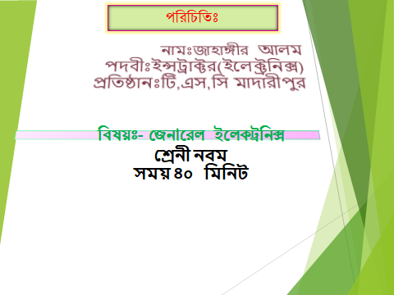

Slide 2

Automation: automation robotization or Industrial Automation or numerical control is the use of control systems such as computer to control industrial machineries and process replacing human operator. Automation greatly reduces the need for human sensory and mental requirements as well. Automation play increasingly important role in global economic and daily expenses
Automation tools:
ANN: Artificial neural network.
DCS: distributed control system
HIM: human machine interface
LIMS: laboratory information management system
MES: manufacturing execution system.
PAC: Programmable automation system
PLC: Programmable Logic Control
SCADA: supervisory control and data acquisition.

Slide 3

Definition
PLC is: A digital electronic device using a programmable memory to store instructions and to implement specific functions such as logic, sequence, counting, timing and arithmetic to control machines and processes through digital or analog input/output modules.

Slide 4

PLC components:
CPU
Rack
Input assembling card
Output assembling card
Power supply
Programming unit software PC
Memory of PLC: Two type memory of PLC.
Volatile losses is content when power is off.
Volatile the content are not loss is absence of power failure
Basic operation of PLC:
1.The operation of PLC is scan or read from the input
2. Execute or solved the logic,
3.Update or write to the output device
A system engineer or plc engineer will first creative programming logic in a programming device. these logic can be written a in a leader logic or functional block diagram chart or any other language. Programmer then download program to the PLC. This is usually done by connecting the programmer to the PLC. Once the program did to the PLC it is not necessary for the PC to remain connected.

Slide 5
PLC components:
CPU
Rack
Input assembling card
Output assembling card
Power supply
Programming unit software PC
Memory of PLC: Two type memory of PLC.
Volatile losses is content when power is off.
Volatile the content are not loss is absence of power failure
Basic operation of PLC:
1.The operation of PLC is scan or read from the input
2. Execute or solved the logic,
3.Update or write to the output device
A system engineer or plc engineer will first creative programming logic in a programming device. these logic can be written a in a leader logic or functional block diagram chart or any other language. Programmer then download program to the PLC. This is usually done by connecting the programmer to the PLC. Once the program did to the PLC it is not necessary for the PC to remain connected.

Slide 6

PLC ARCHITECTURE
Programmable controllers replace most of the relay panel wiring by software programming.
A typical PLC

Slide 7
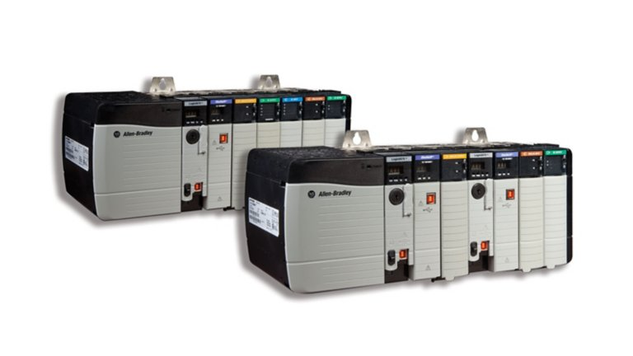
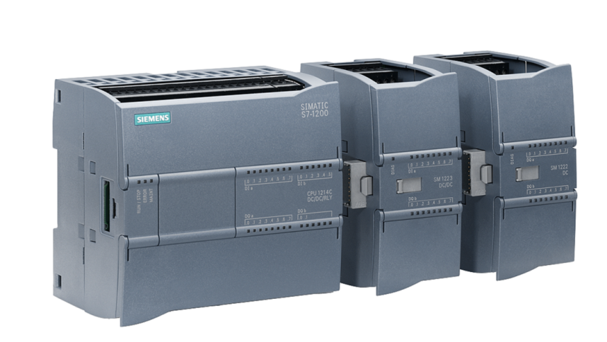
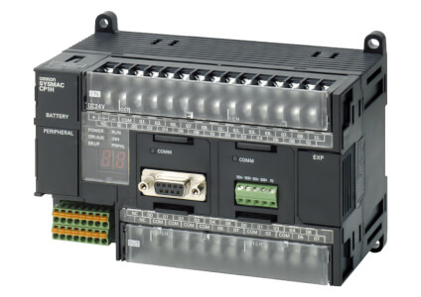
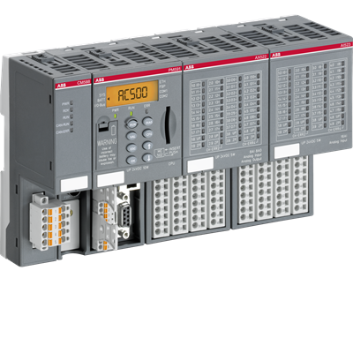
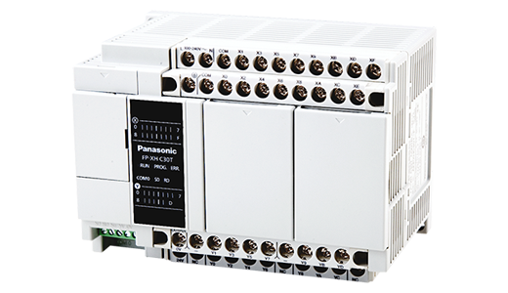
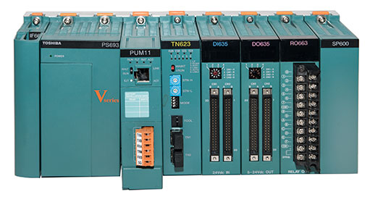
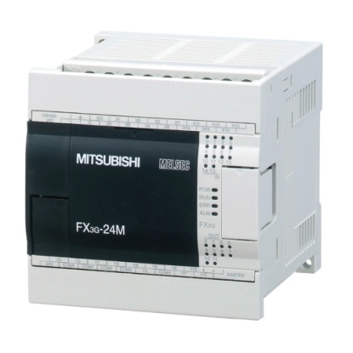
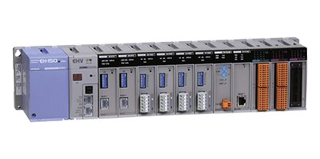
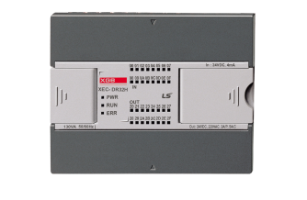
Commonly available brands of PLC in the market
Siemens
Allen Bradley
ABB
Omron
Delta
Honeywell
GeFanuc
Schneider Electric (Previously Modicon)
Mitsubishi
Delta
Yokogawa
Toshiba
Hitachi
Fuji
Panasonic
Fatek
Kinco
Inovance
Unitronics
Eaton
Bosch
Beckhoff
Wago
LS PLC
Allen Bradley
Siemens
Omron
ABB
Panasonic
Toshiba
Mitsubishi
Hitachi
LS PLC

Slide 8
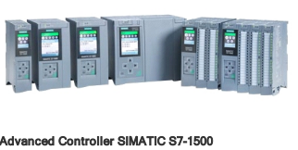
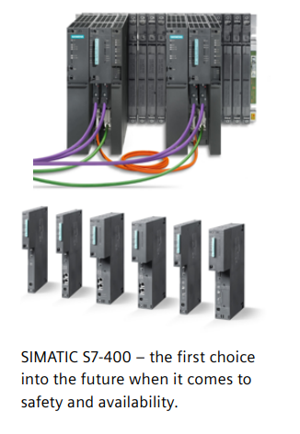
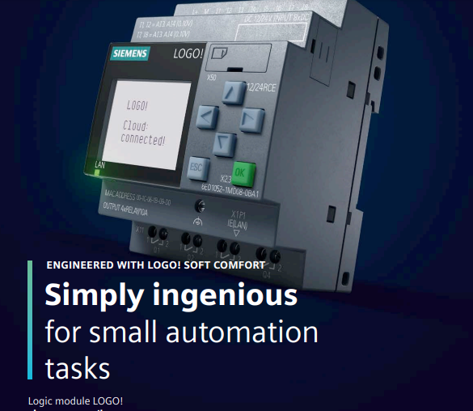
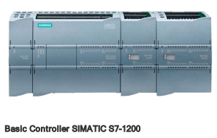

Slide 9
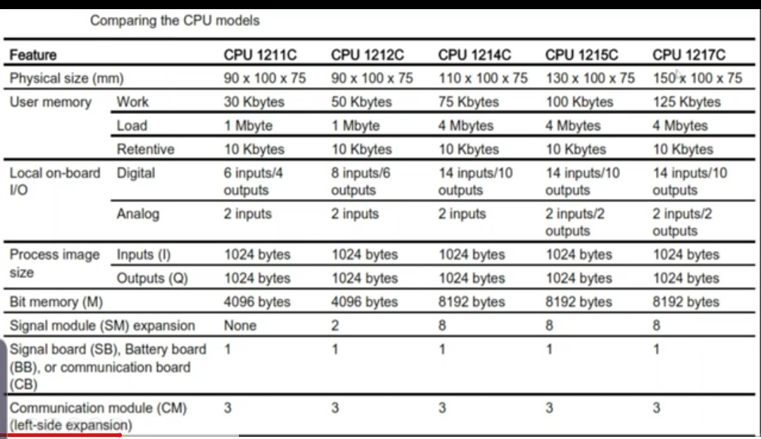

Slide 10
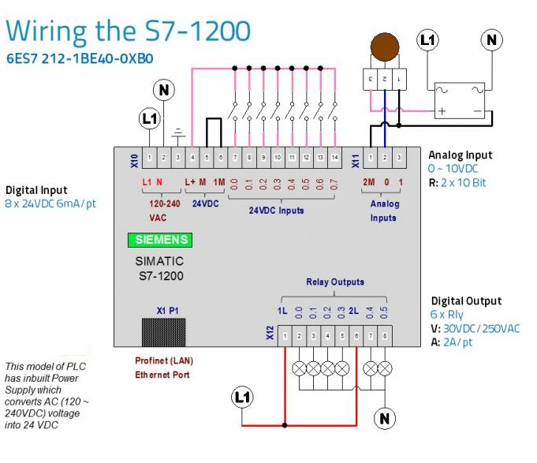

Slide 11
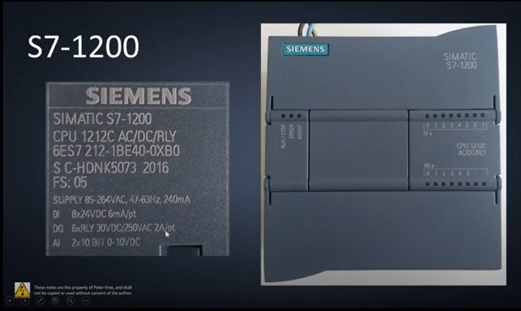

Slide 12
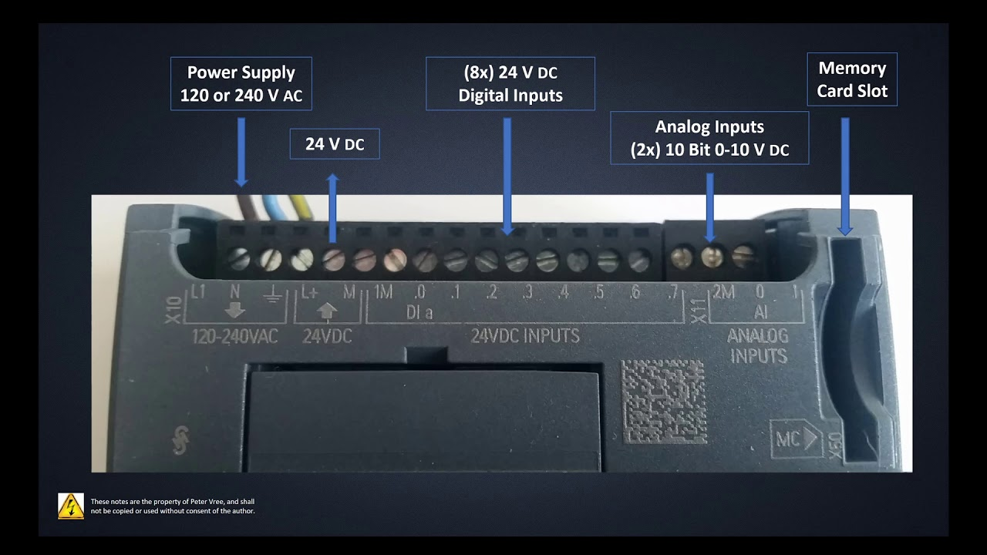

Slide 13
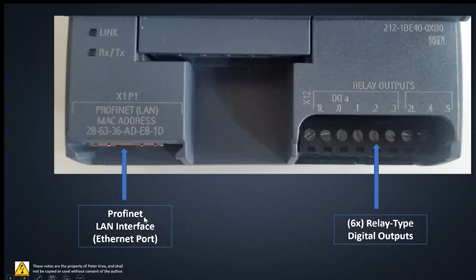

Slide 14
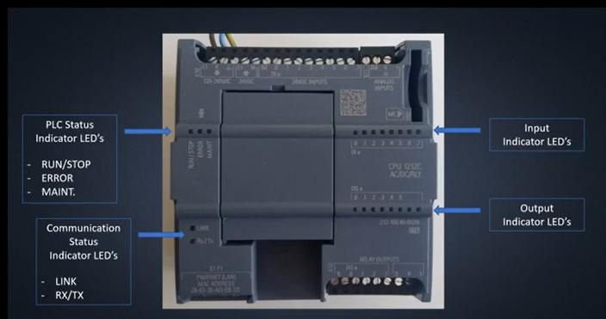

Slide 15
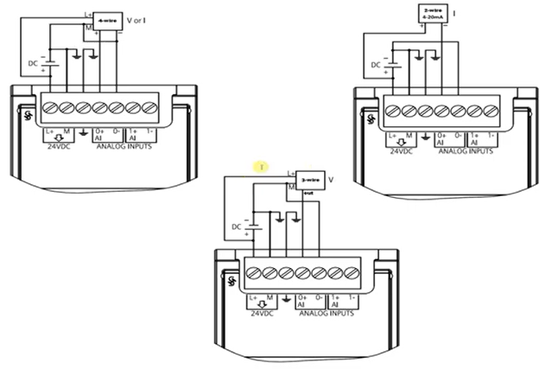

Slide 16
SIMATIC S7-1200 modules at a glance
The S7-1200 controller is designed as a compact CPU, which means that IOs are already integrated. Yet the S7-1200 station can be equipped with additional IO modules to enlarge the capabilities of the PLC.
Application
With the integrated technology functions such as High Speed Counter, pulse width modulation, pulse sequence outputs, speed control and positioning, SIMATIC S7-1200
Controllers are suitable for temperature controls, pump and fan controls, as well as conveyor technology including packaging machines.

Slide 17
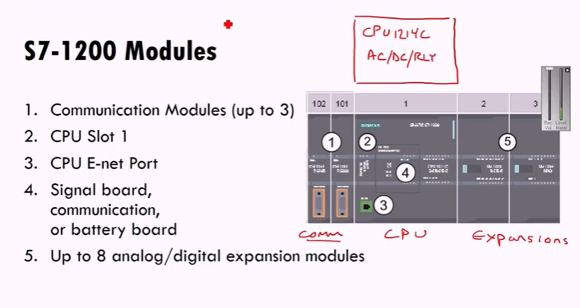

Slide 18
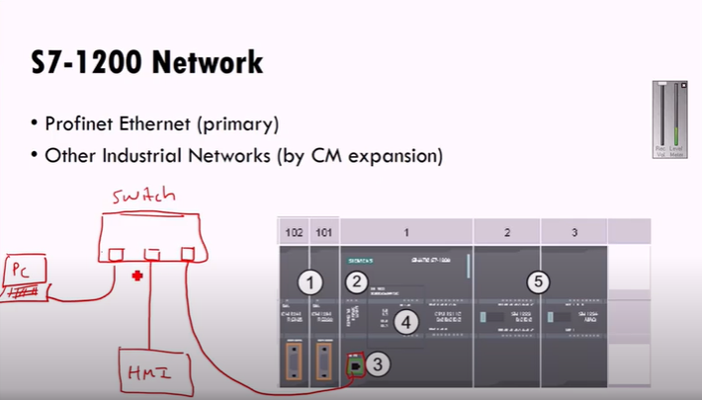

Slide 19
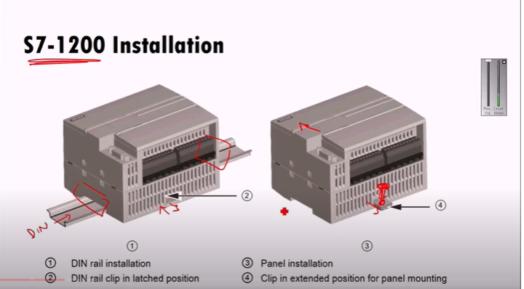

Slide 20
PLC- Sensors / actuators
Device which converts the signal from one form to another.
Sensors
  Analog: Temperature, pressure, humidity, level, flow, weight…
  Digital: Level, pushbutton (emergency stop), position switch, photoelectric sensor…
Actuators
  Analog: valve, pump, heater, power supply…
  Digital: Signaling column, contactor, electro valve, switch, OnOff pump…

Slide 21
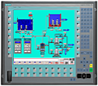

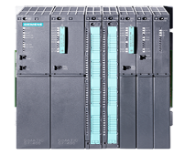
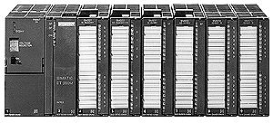





PLC- Hardware Overview
Supervisory Control And Data Acquisition
SCADA
ETHERNET TCP/IP
PLC
INDUSTRIAL FIELDBUS
DIRECT WIRING
REMOTE I/O
SENSORS/ACTUATORS

Slide 22
PLC- Periphery stations
Communication modules.
I/O Modules.
  Convert physical value into numeric value and vice versa.
Function modules.

Slide 23
PLC- Communication modules
Ethernet
Profibus
CAN
Point to Point
Serial RS 232, RS 485
AS-Interface
Modbus…

Slide 24
PLC- Input / Output modules
Analog
  16-bit signed from -32768 to 32767.
  Inputs: Resistance, Current, Voltage, thermocouple…
  Outputs: Current, voltage.
Digital
  1-bit
  Inputs: 120v-230v AC, 24v DC
  Outputs: Relay, 120v-230v AC, 24v-48v-125v DC.

